Slide 1

Trends in Videos
Eilish Boyd, Leticia Salazar
and Alyssia Smith

Slide 2

Purpose:
Youtube is one of the most used video platforms used today. We’re constantly seeing in the news or on other social media platforms about trending topics. So we chose to analyze the trending topics on YouTube based on their categories. We utilized Python, Matplotlib, and Pandas to analyze our data and present our findings throughout the project. We analyzed datasets from the United States, Russia, Japan, Korea, and India to see any comparison between the different countries.
Notes:
Based on our own personal experiences with social media, we had theories on what those factors might be
Influenced which parts of the data we used and focused on

Slide 3
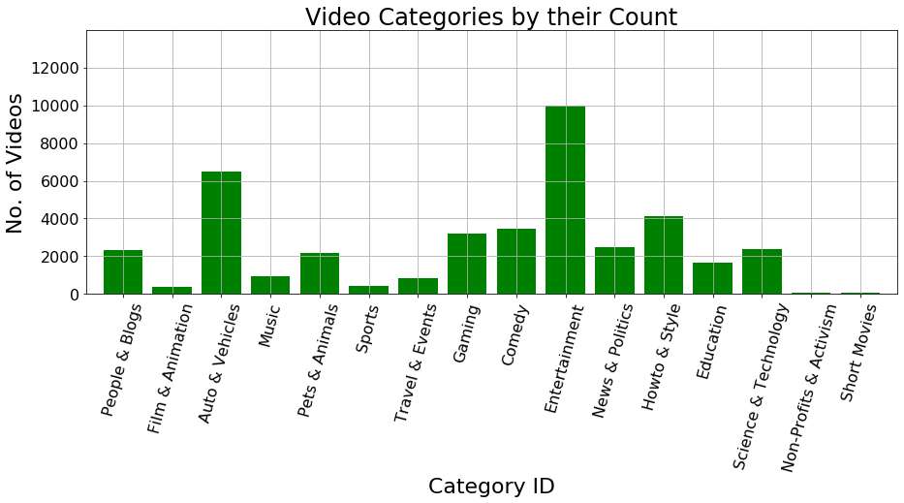
Highest Trending Videos Based on their Category ID:
Highest Trending Videos are:
Entertainment(10,000), followed by Auto & Vehicle(~6000).
Lowest Trending Videos are:
Short Movies and Non-Profits & Activism
My prediction was that Music & Sports would have been up there with Entertainment.

Slide 4
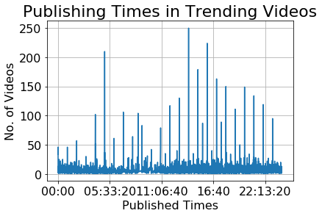
Trending Videos and their Published Times:
In a span of 24 hours there is a lot of fluctuation on how many trending videos get uploaded.
There are two major trending periods:
Early morning
2. Afternoon

Slide 5
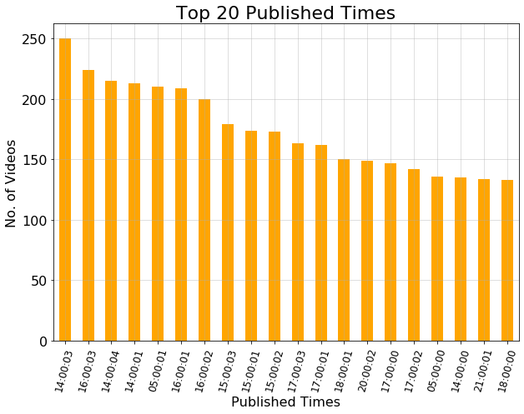
A closer look:
From the 24 hour span, here is the top 20 published timed.
Between the times of 2 PM and 6 PM you have the highest number of videos being uploaded.
One outlier is 5 AM where it has the most number of videos being uploaded.

Slide 6
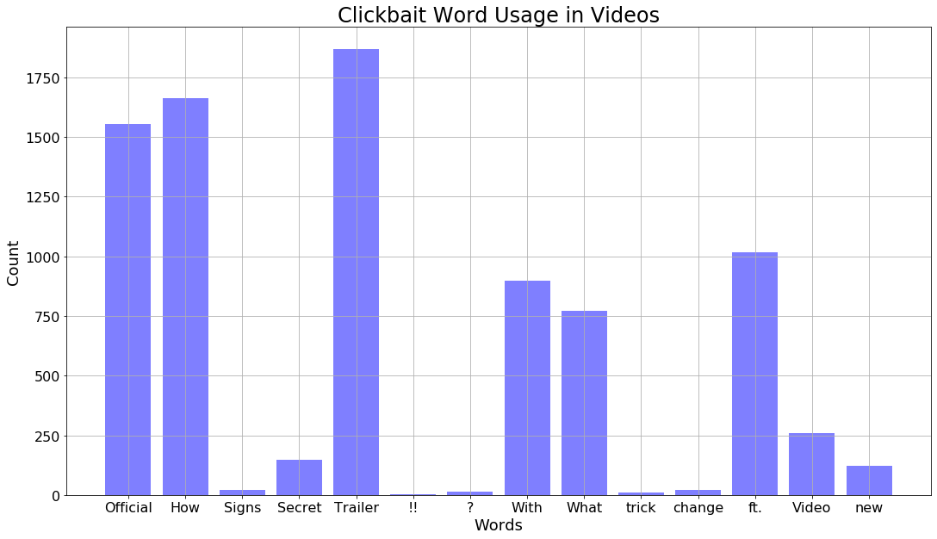

How Many Trending Video Titles Contain ….
We wanted to measure if how many youtube users use “clickbait” words that attract viewers to click on their video. Looking at the data you can see that the most frequent words used in our dataset are “Trailer”, “How”, and “Official”. However, what was interesting to see while analyzing this was seeing how punctuation marks also play a role in what youtubers use to attract viewers to their videos.

Slide 7
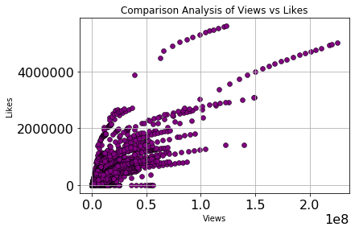
Comparison of Views vs. Likes
The scatter plot graph shows that the as the views on a youtube video increases so does the likes. I wanted to measure this dataset because you can see that there is a clear correlation between the two data’s.
Notes:
Bar Graph

Slide 8
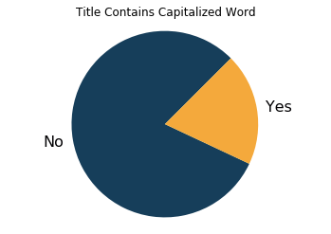
How Many Trending Video Titles contain Capitalized Word
There is not a strong correlation between title format and trending videos
There were a greater number of trending videos that did not contain a capitalized word in the title
Notes:
Popular YouTube channels use similar formats in their video titles which made me wonder if that could be a contributing factor to their content being successful/generating traffic (all caps, key-words/clickbait terms capitalized)

Slide 9
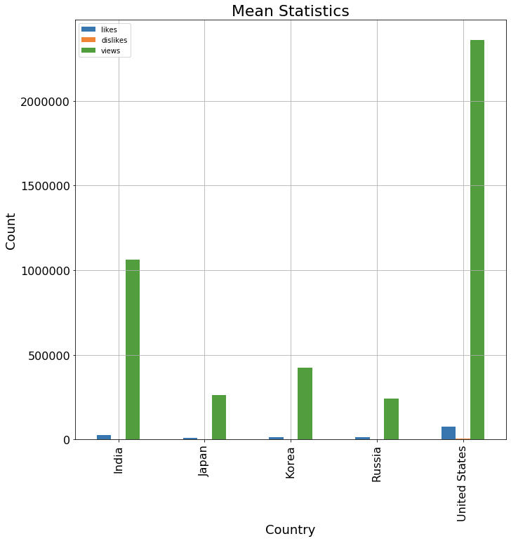
Comparison of Likes vs. Dislikes
On average, videos with a greater number of ‘likes’ than ‘dislikes’ received more views
Trending videos in the U.S. received more likes and views than trending videos in India, Japan, Korea and Russia
Notes:
Calculated the average number of likes, dislikes and views of a video across all 5 countries
Although not all countries consume the same amount of content, the data showed that likes likes matter more than dislikes
Trending videos have more likes than dislikes,

Slide 10
Likes, Dislikes and Views → Conclusions
The United States contributed the most to ‘Views’ followed by India
Japan, Korea and Russia followed (consistent with each other)
There is a positive correlation between ‘Likes’ and ‘Views’ of a trending video
Because the number of ‘Dislikes’ on a trending video are significantly lower than the number of ‘Likes’, ‘Dislikes’ pale in comparison

Slide 11
‘Likes’
+
‘Views’
--------------------------
Trending Video
Notes:
We used video id to compare ‘likes’ to ‘views’ by dividing the number of ‘likes’ (from different countries) by the number of United States ‘views’
This showed what percentage of those ‘likes’ contributed to the ‘views of that video id

Slide 12
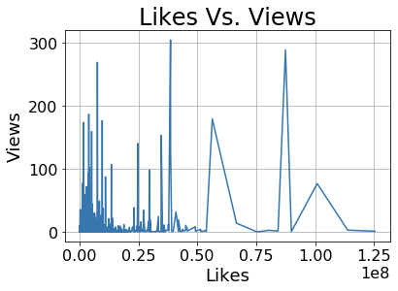
India vs. United States

Slide 13
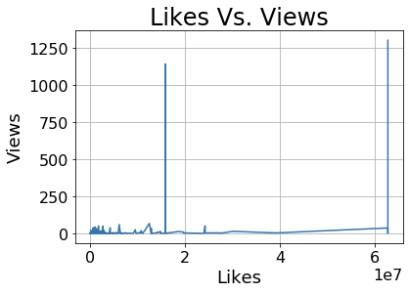
Japan vs. United States

Slide 14
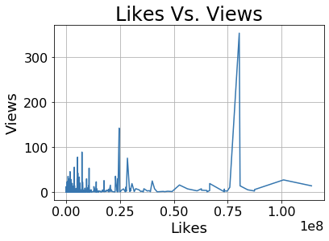
Korea vs. United States

Slide 15
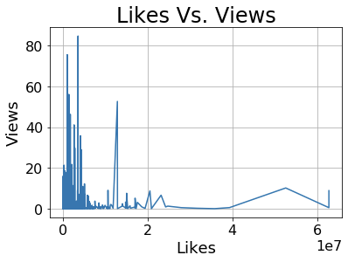
Russia vs. United States

Slide 16
Conclusion
The dataset that we found on Kaggle contains data about 40000+ videos between the years of 2017 - 2018. We chose this topic because social media has a huge influence on society therefore we wanted to measure the activity on the videos being posted. It was interesting comparing the content from the US to other countries around the world because you can see how many people utilize youtube around the world. Some of the obstacles that we had during this project was surprisingly just trying to get the graphs to print in the Jupyter notebook, increasing the sizes of the graphs and trying to get the encoding for some of the countries we have chosen such as Korea Russia, and Japan. Overall, the outcome of the project gave us some insight to how YouTubers use their content to attract viewers to watch their videos. Some key takeaways are using keywords, the times when you are posting the videos, and knowing the audience that you are looking to attract.

Slide 17
Questions?

Slide 18


Credits to: Wolfgang & Google

